Slide 1

AI-Based MPPT Systems: Comparative Study and Techno-Economic Feasibility
By :-
Ajinkya Choure (22BEE007) Aryan Adit (22BEE018)
Faculty Mentor- Dr. Manisha Shah
Department of Electrical Engineering, Institute of Technology,
Nirma University

Slide 2
Objectives of the Study
Main Aim: To evaluate and compare AI-based MPPT algorithms with the conventional P&O method, and assess their techno-economic feasibility for large-scale PV systems.
Specific Objectives:
Model Development: Build MATLAB/Simulink models of P&O and AI-based (ANN/ANFIS) MPPT controllers.
Technical Evaluation: Compare tracking efficiency, convergence time, oscillations, robustness under shading/noise.
Industrial Gap Analysis: Investigate why AI MPPT, despite superior performance, is not widely adopted in industry.
Techno-Economic Assessment: Analyze feasibility of large-scale AI MPPT adoption (case study: utility PV plant).
Recommendations: Propose solutions and a roadmap for AI-based MPPT integration in real-world solar power plants.

Slide 3
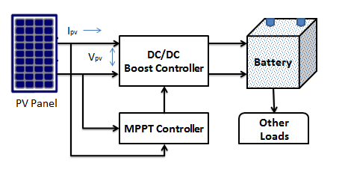
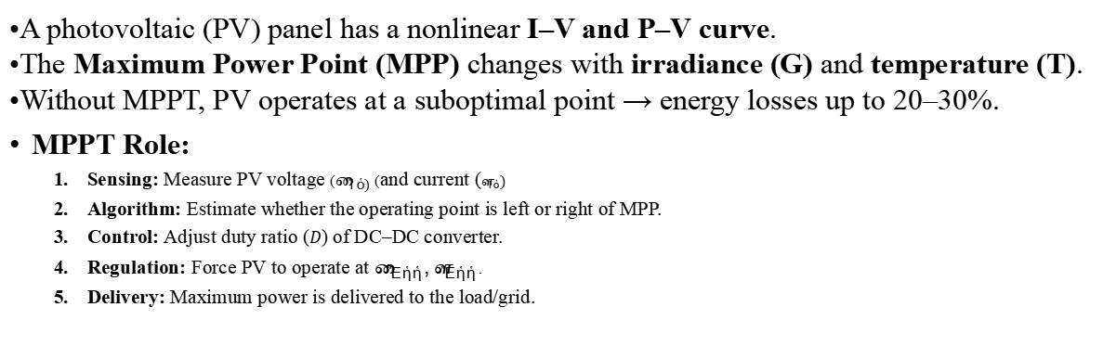
What is an MPPT System
A photovoltaic (PV) panel has a nonlinear I–V and P–V curve.
The Maximum Power Point (MPP) changes with irradiance (G) and temperature (T).
Without MPPT, PV operates at a suboptimal point → energy losses up to 20–30%.
MPPT Role:
Sensing: Measure PV voltage ($V_{pv)}$) and current ($I_{pv})$
Algorithm: Estimate whether the operating point is left or right of MPP.
Control: Adjust duty ratio ($D$) of DC–DC converter.
Regulation: Force PV to operate at $V_{MPP},I_{MPP}$.
Delivery: Maximum power is delivered to the load/grid.

Slide 4
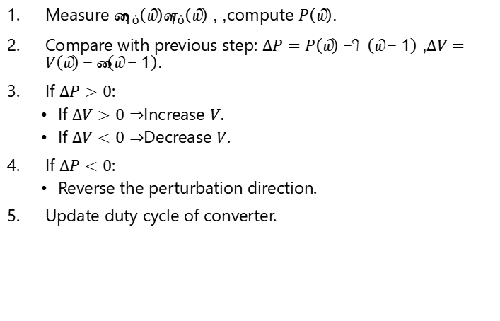
Perturb & Observe (P&O) MPPT
Measure $V_{pv}\left(k\right)$, $I_{pv}\left(k\right)$, compute $P\left(k\right)$.
Compare with previous step: $ΔP=P\left(k\right)−P\left(k−1\right)$, $ΔV=V\left(k\right)−V\left(k−1\right)$.
If $ΔP>0$:
If $ΔV>0⇒$Increase $V.$
If $ΔV<0⇒$Decrease $V$.
If $ΔP<0$:
Reverse the perturbation direction.
Update duty cycle of converter.
Advantages
Simple, low-cost, easy to implement on microcontrollers.
Drawbacks
Oscillates around MPP in steady state → power loss.
Slow convergence under fast irradiance transients.
May mis-track under partial shading (local maxima problem).

Slide 5
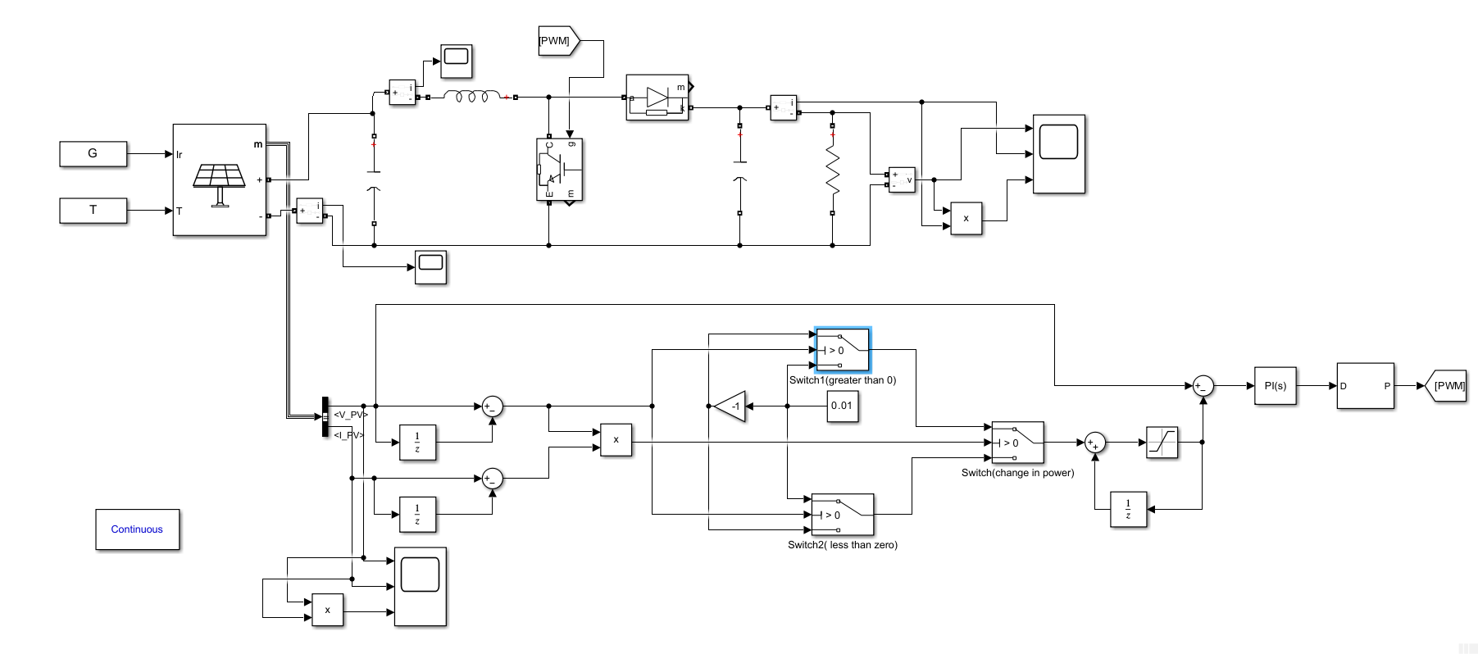
Simulink Simulation of P&O MPPT System

Slide 6
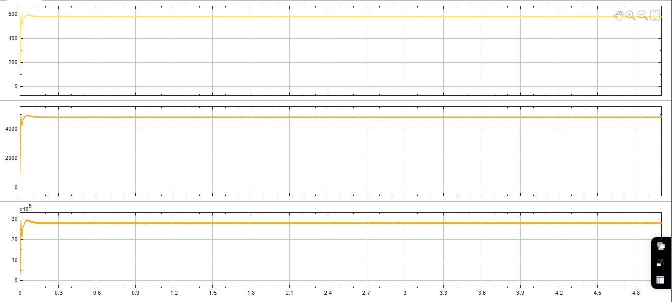
Results
Output Voltage
Output Current
Output Power

Slide 7
ANN-Based MPPT System
Working Principle
Input Parameters: The ANN receives PV voltage (V) and PV current (I) as input signals.
Learning Relationship: It learns the nonlinear mapping between (V, I) and the optimal duty cycle (D) of the DC–DC converter through training.
Control Action: Instead of directly changing the PV voltage, the ANN adjusts the duty cycle of the converter.
Indirect Regulation: By controlling the duty cycle, the ANN indirectly regulates the PV operating voltage and current.
Real-Time Adaptation: The ANN continuously updates its output duty cycle to track the Maximum Power Point (MPP).
Environmental Adaptability: It ensures reliable operation under varying irradiance and temperature conditions.
Result: Provides a data-driven and adaptive control strategy that improves tracking accuracy compared to conventional MPPT algorithms.

Slide 8
ANN-Based MPPT System
Advantage
Handles Nonlinear Behavior: Effectively manages the nonlinear I–V characteristics of PV systems.
Fast Convergence: Tracks the MPP faster than traditional methods like P&O.
Reduced Oscillations: Minimizes steady-state oscillations, resulting in higher energy yield.
Robustness: Performs well under partial shading, irradiance fluctuations, and noise.
No Exact PV Model Required: Operates effectively without detailed mathematical modeling of the PV system.
Disadvantages
Training Data Requirement: Needs a sufficiently large and diverse dataset for accurate training.
Computational Complexity: Requires more processing power and memory compared to P&O or Incremental Conductance methods.
Architecture Sensitivity: Performance depends on the chosen network structure, training algorithm, and parameter tuning.
Limited Generalization: An ANN trained for one PV system may require retraining or fine-tuning for another system or environment.

Slide 9
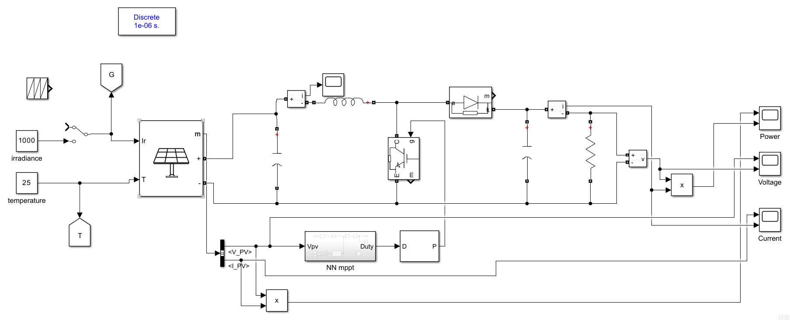
Simulink Simulation of ANN based MPPT System

Slide 10
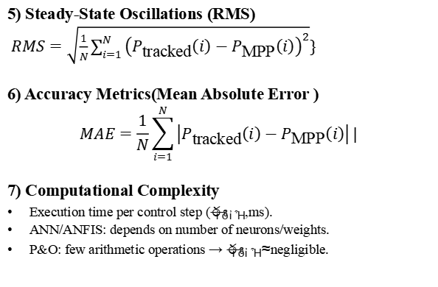
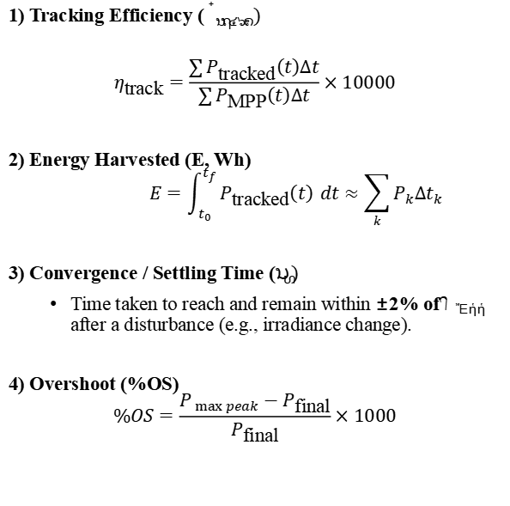
Parameters for Comparison of MPPT Techniques
1) Tracking Efficiency ($η_{track})$
$$η_{\text{track}}=\frac{\sum{P_{\text{tracked}}\left(t\right)Δt}}{\sum{P_{\text{MPP}}\left(t\right)Δt}}×10000$$
2) Energy Harvested (E, Wh)
$$E=\int_{t_{0}}^{t_{f}}{P_{\text{tracked}}\left(t\right)} dt≈\sum_{k}{P_{k}Δt_{k}}$$
3) Convergence / Settling Time ($t_{s})$
Time taken to reach and remain within ±2% of $P_{MPP}$ after a disturbance (e.g., irradiance change).
4) Overshoot (%OS)
$$\%OS=\frac{P_{ max peak}−P_{\text{final}}}{P_{\text{final}}}×1000$$
5) Steady-State Oscillations (RMS)
$RMS=\sqrt{\frac{1}{N}\sum_{i=1}^{N}{{\left(P_{\text{tracked}}\left(i\right)−P_{\text{MPP}}\left(i\right)\right)}^{2}}}\}$
6) Accuracy Metrics(Mean Absolute Error )
$$MAE=\frac{1}{N}\sum_{i=1}^{N}{\left|P_{\text{tracked}}\left(i\right)−P_{\text{MPP}}\left(i\right)\right|}|$$
7) Computational Complexity
Execution time per control step ($t_{exec}$, ms).
ANN/ANFIS: depends on number of neurons/weights.
P&O: few arithmetic operations → $t_{exec}≈$negligible.

Slide 11
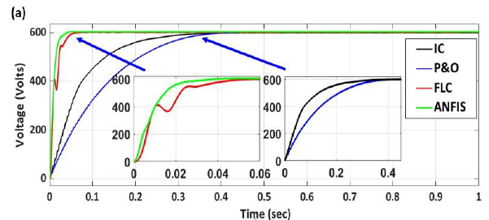
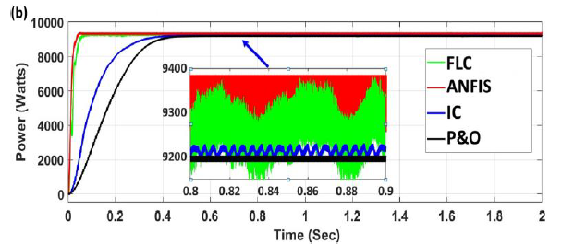
Expected Output
What We Expect to See
Faster convergence of ANN/ANFIS compared to P&O.
Higher steady-state power extraction (~2% more than P&O).
Reduced oscillations around MPP for AI-based MPPT.
Improved tracking efficiency (> 99% vs ~96–97% for P&O).
Robustness under step irradiance change (ANN/ANFIS settle within ~0.035s vs P&O ~0.45s).
Our Target
Replicate similar performance trends in our MATLAB/Simulink simulations.
Validate improvement metrics:
Tracking Efficiency
Settling Time
Oscillation Amplitude
Extracted Energy

Slide 12
Metric | P&O | ANN
Convergence Time | 0.45 s | 0.035 s
Extracted Power | 9200 W | 9380 W
Tracking Efficiency | ~93% | ~98%
Oscillations | High | Very Low
Robustness | Weak | Strong
Complexity | Simple | High

Slide 13
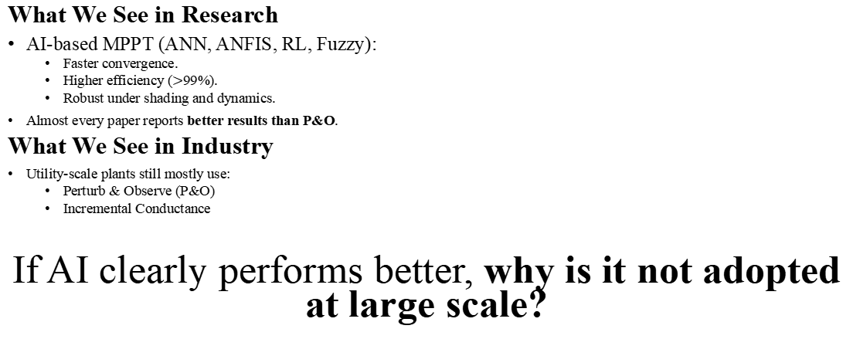
Research vs Industry: Where is the Gap?
What We See in Research
AI-based MPPT (ANN, ANFIS, RL, Fuzzy):
Faster convergence.
Higher efficiency ($>$99%).
Robust under shading and dynamics.
Almost every paper reports better results than P&O.
What We See in Industry
Utility-scale plants still mostly use:
Perturb & Observe (P&O)
Incremental Conductance
If AI clearly performs better, why is it not adopted at large scale?

Slide 14
References
[1] M. R. Javed, A. Waleed, U. S. Virk, and S. Z. ul Hassan, "Comparison of the Adaptive Neural-Fuzzy Interface System (ANFIS) based Solar Maximum Power Point Tracking (MPPT) with other Solar MPPT Methods," [Conference/Journal details missing], UET Lahore (Faisalabad Campus), Pakistan.
[2] A. Waleed, K. Hassan, and U. S. Virk, "Designing a dual axis solar tracker for optimum power," Journal of Electrical Engineering, vol. 14, pp. 168–173, 2014.

